Slide 1
ONLINE COMPLAINT REGISTRATION AND MANAGEMENT SYSTEM
TEAM NUMBER: ITG20
TEAM MEMBERS:
SWETHA A (211521205162)
SWETHA J (211521205164)
TEJA SHREE P (211521205167)
VAISHNAVI M (211521205171)

Slide 2
TABLE OF CONTENTS
ABSTRACT
INTRODUCTION
PROPOSED SYSTEM
BLOCK DIAGRAM
MODEL SCREENSHOT
CONCLUSION

Slide 3
ABSTRACT
The Online Complaint Registration and Management System is a full-stack MERN (MongoDB, Express.js, React, Node.js) web application designed to provide a centralized platform for users to submit and track complaints in an efficient and secure manner. The system streamlines complaint resolution by assigning issues to appropriate agents, allowing real-time tracking and interaction, and sending automated notifications. Enhanced by features like user authentication, intelligent routing, and data security, this platform offers a robust solution for improving complaint management and customer satisfaction.

Slide 4
INTRODUCTION
Complaint management is a critical function for any organization that aims to maintain high customer satisfaction and adherence to regulatory standards. Traditionally, complaint handling processes have been paper-based or involve slow, manual operations that lead to inefficiencies. To address these challenges, the Online Complaint Registration and Management System leverages modern web technologies to provide an easy-to-use, accessible platform for submitting and resolving complaints. Built using the MERN stack, the system offers end-to-end management of complaints, from registration and tracking to final resolution, thereby optimizing the complaint-handling process.

Slide 5
PROPOSED SYSTEM
The proposed system is a web-based platform that enables users to:
Register and log in to their accounts.
Submit detailed complaints by filling out relevant information, such as description, contact details, and attached documents.
Track the progress of their complaints in real-time and receive notifications about status updates via email or SMS.
Communicate directly with assigned agents to provide additional details or feedback.
Experience enhanced security with features like data encryption, user authentication, and compliance with data protection laws.
The system also empowers administrators to oversee the allocation and resolution of complaints, ensuring timely handling and proper resource allocation. Intelligent routing algorithms assign complaints to the right department, while the admin can monitor the performance of agents and maintain the overall system.

Slide 6
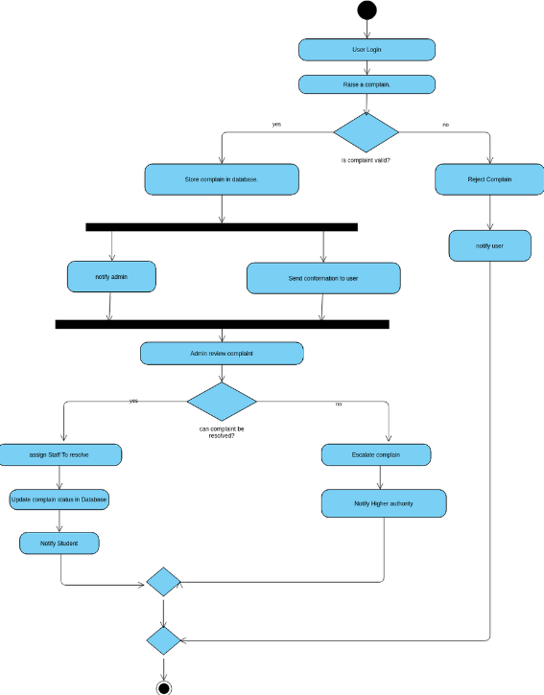
BLOCK DIAGRAM

Slide 7
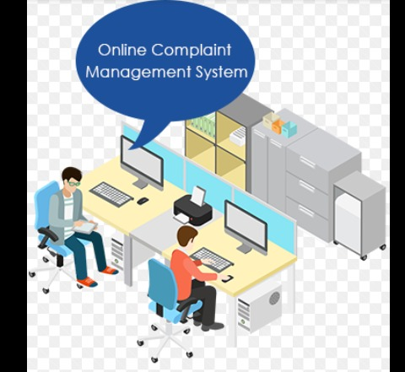
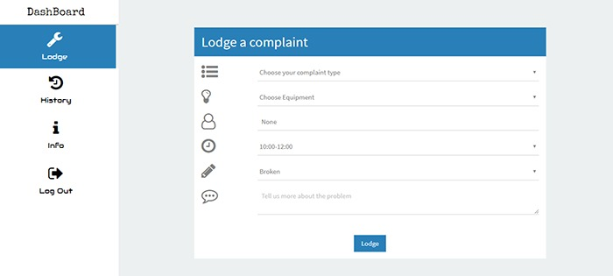
MODEL SCREENSHOT

Slide 8
CONCLUSION
The Online Complaint Registration and Management System offers a comprehensive solution for organizations to manage and resolve complaints efficiently. By leveraging the MERN stack, the system ensures a responsive and user-friendly interface, secure data handling, and streamlined complaint resolution processes. This platform not only reduces the administrative burden of complaint handling but also enhances user satisfaction through real-time updates and communication. Its scalability makes it suitable for organizations of varying sizes and industries.

